Slide 1
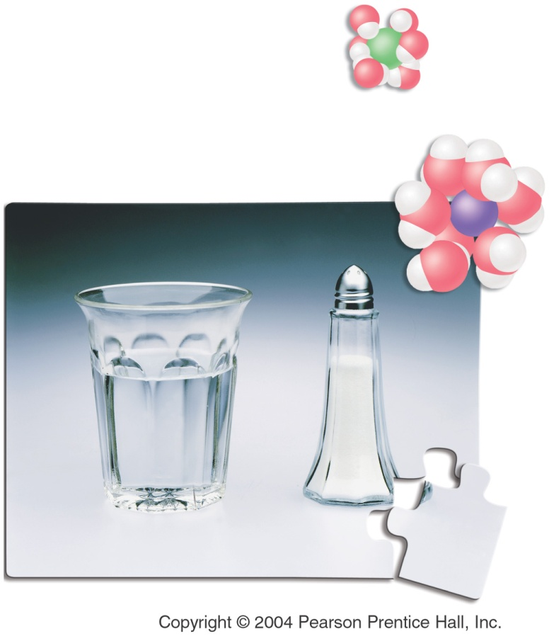
Chapter 14
Solutions
Outline
Solutions
Units of Concentration
Properties of Solutions
Solubility
Reactions
Colligative Properties
I have no doubt that in reality the future will be vastly more surprising than anything I can imagine. Now my own suspicion is that the universe is not only queerer than we suppose, but queerer than we can suppose.
John Burdon Sanderson Haldane

Slide 2
How are solutions quantified?

Slide 3
What is the mass percent of the solution?

Slide 4
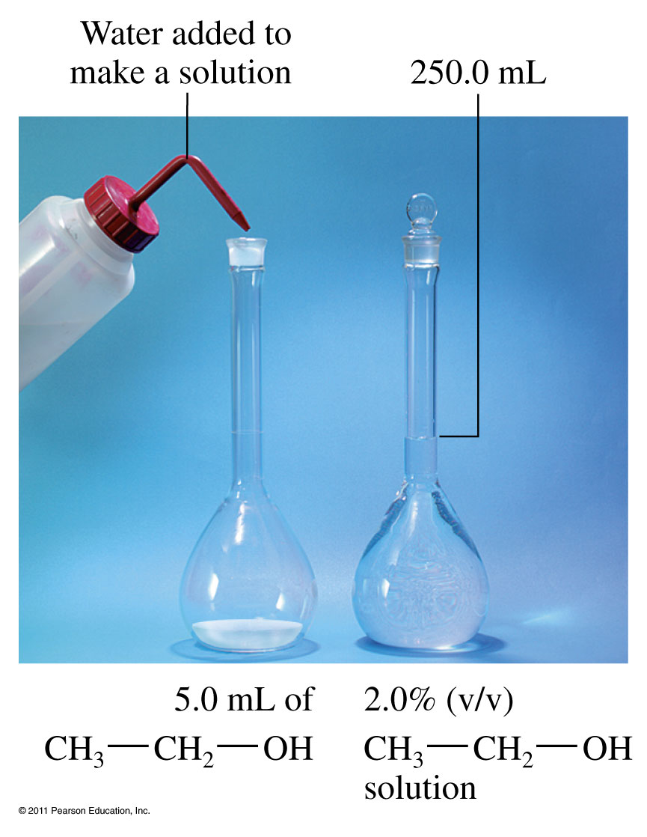
What is volume percent, v/v%?

Slide 5
Example – Mass Percent
A solution consists of 31.7 g of AgNO₃ in 52.0 g of water. What is the mass % of AgNO₃?

Slide 6
Example – Mass Percent
How much of a 25.0% glucose solution is needed to get 56.1 g of glucose?

Slide 7
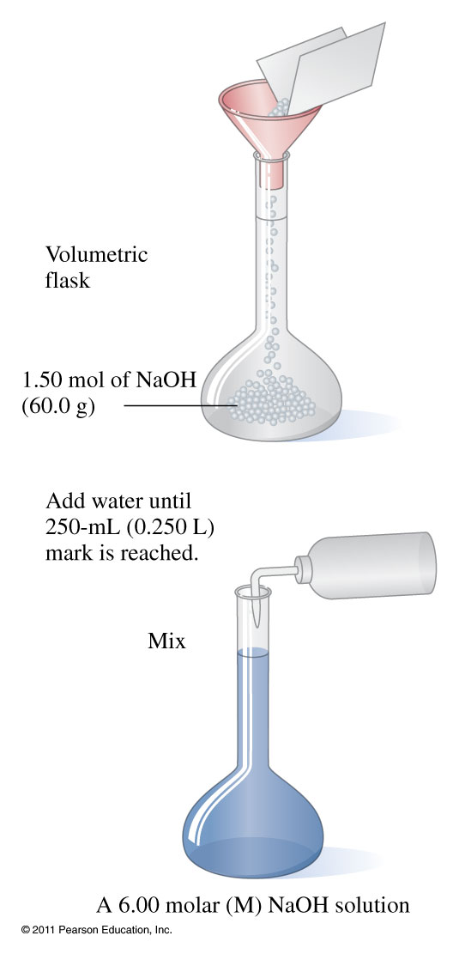
How do you prepare a solution?

Slide 8
Example - Molarity M = moles/L
What is the molarity of a sodium hydroxide solution that contains 24.6 g of NaOH dissolved to 500.0 mL total volume?

Slide 9
Example - Molarity
Calculate the volume of a 2.50 M sugar solution containing 0.400 mol of sugar.

Slide 10
Example - Molarity
What volume of 3.0 M NaOH can be prepared from 52.0 g NaOH?

Slide 11
Example – Molarity
What mass of solute is dissolved in 25.0 mL of 0.500 M CuCl₂?

Slide 12
Example – Units of Concentration
Calculate the molarity of a solution that is 30.0% glucose, C₆H₁₂O₆, and has a density of 1.42 g/mL.

Slide 13
Example – Units of Concentration
Calculate the % acetic acid in a solution of vinegar that is 3.50 M in acetic acid and has a density of 1.06 g/mL.

Slide 14
How does concentration change during a dilution?

Slide 15
Example - Dilutions
A concentrated acetic acid is 20.0 M. What is the new molarity if 10.00 mL is diluted to 50.00 mL with distilled water?

Slide 16
Example - Dilution
What volume in mL of a 0.20 M strontium chloride solution can be prepared by diluting 5.00 mL of a 1.0 M stock solution?

Slide 17
Solution Stoichiometry

Slide 18
Example - Solution Stoichiometry
Calculate the mass of BaSO₄ formed from 0.104 L of 2.00 M H₂SO₄ and excess Ba(OH)₂.

Slide 19
Example - Solution Stoichiometry
Antacids containing CaCO₃ react with stomach acid according to the reaction:
CaCO_{3 (s)} + 2 HCl _{(aq)} ⎯→ CaCl_{2 (aq)} + CO_{2 (g)} + H₂O _{(l)}
The normal volume acid in the stomach is between 20 – 100 mL.
How much CaCO_{3 (s)} is needed to react with 62.0 mL of 6.0 M HCl?

Slide 20
Example - Solution Stoichiometry
Given that 25.0 mL of a 0.100 M MgBr₂ solution completely reacts with 13.9 mL of a AgNO₃ solution, what is the molarity of the AgNO₃ solution?

Slide 21
Example - Solution Stoichiometry
What volume in mL of a 0.75 M sodium carbonate solution is required to completely react with 15.0 mL of 6.00 M hydrochloric acid? Given:
Na₂CO_{3 (aq)} + 2 HCl _{(aq)} → 2 NaCl _{(aq)} + H₂O_{(l)} + CO_{2 (g)}

Slide 22
What are the common types of solutions?
Gaseous gas in gas
liquid in gas
Liquid gas in liquid
liquid in liquid
solid in liquid
Solid liquid in solid
solid in solid

Slide 23
How does pressure affect gas solubility?

Slide 24
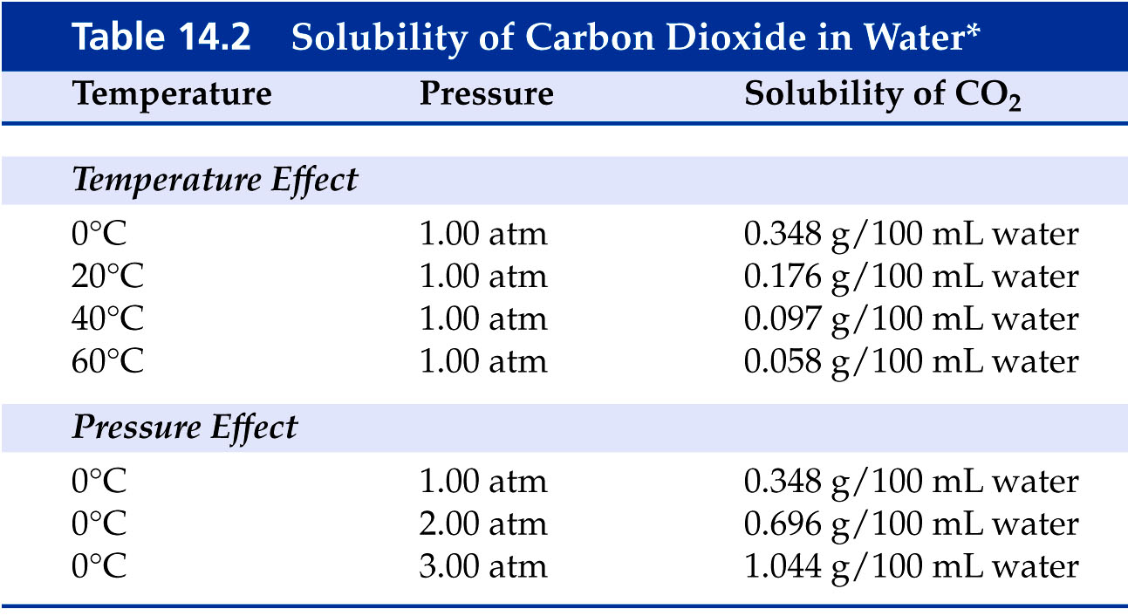

Slide 25
Example - Henry’s Law
If the solubility of nitrogen is 1.90 mg/100mL blood at 1.00 atm, what is the solubility of nitrogen in a scuba diver’s blood at a depth of 155 feet where the pressure is 5.50 atm?

Slide 26
Example - Solubility
Which of the following pairs are miscible?
Water and ethanol, CH₃CH₂OH
Hexane, CH₃(CH₂)₄CH₃ and xylene,
Ethanol, CH₃CH₂OH, and xylene,
A and B
All of the above

Slide 27
How do liquids mix into solutions?

Slide 28
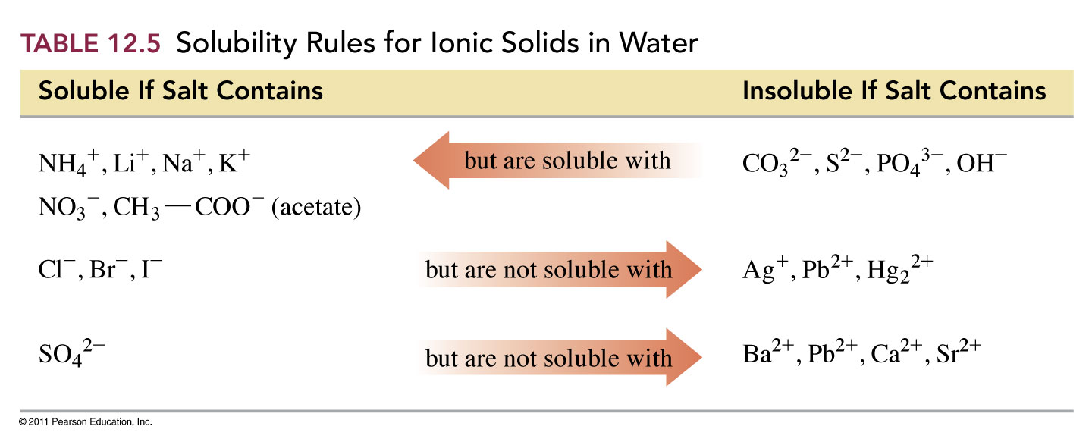
How do solids mix in solutions?

Slide 29
What causes substances to dissolve?

Slide 30
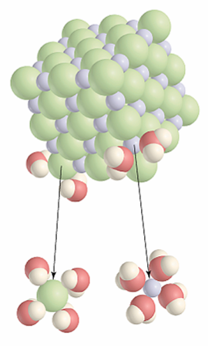
What is a solvent cage?

Slide 31
How do ionic compounds dissociate?

Slide 32
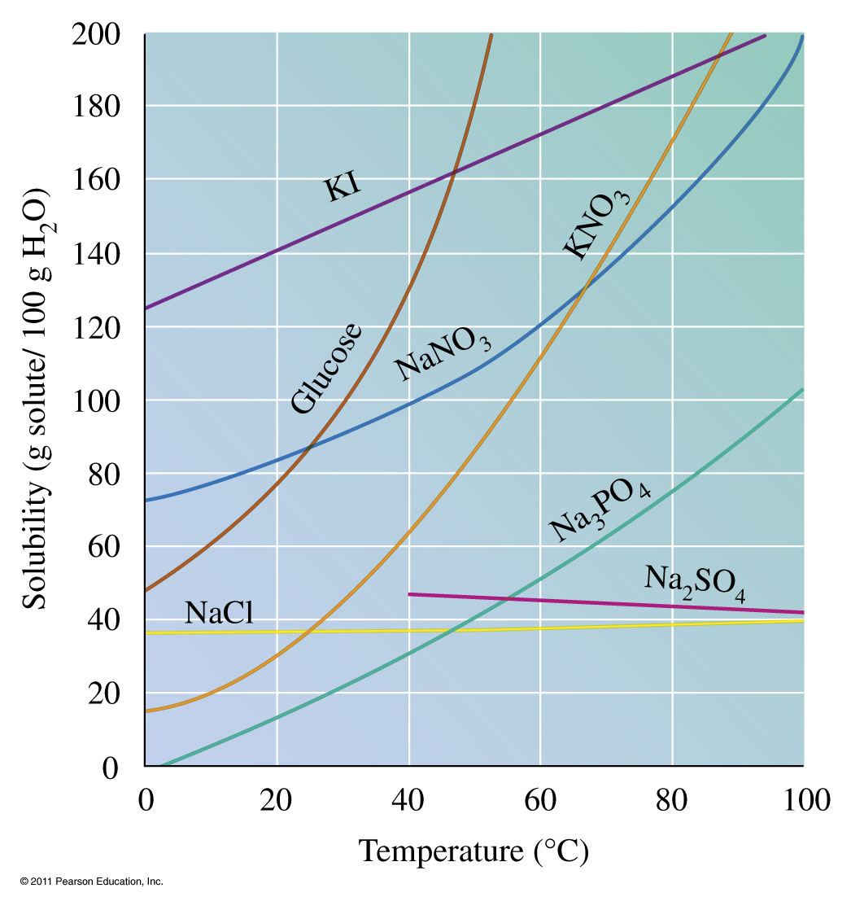
How are solubility and temperature related?

Slide 33
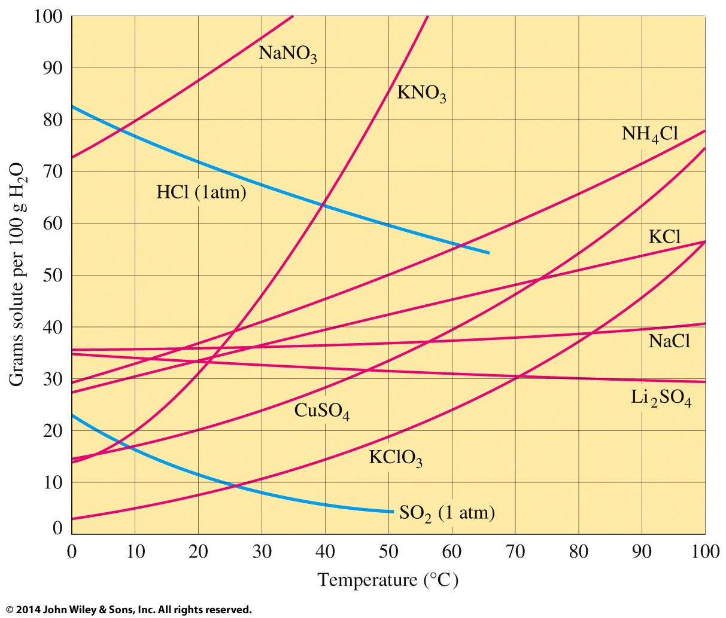
How are solubility and temperature related?

Slide 34
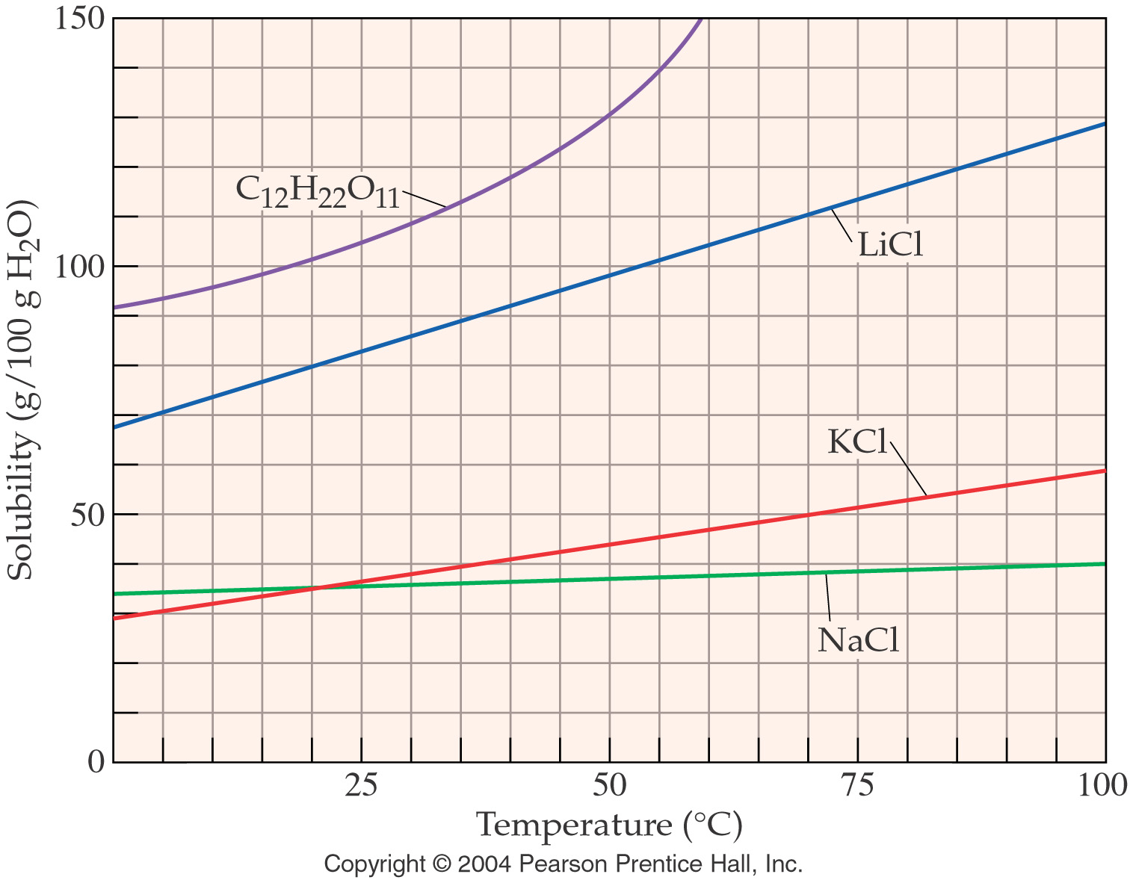

Slide 35
Example - Solutions
What type of solution is sodium acetate at 75 °C and 50g/100 g H₂O?
Saturated
Unsaturated
Supersaturated
Not enough information

Slide 36
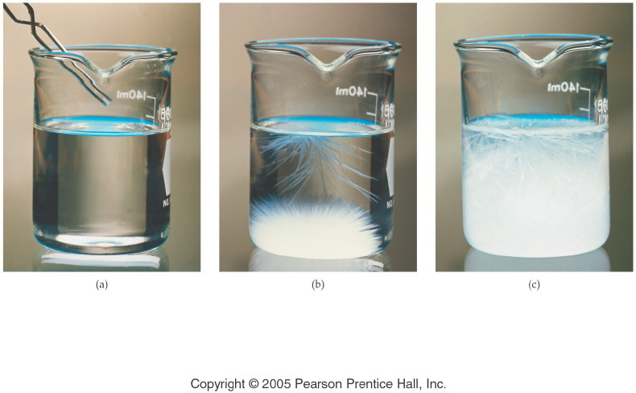
What happens to a supersaturated solution if more solute is added?
Notes:
Figure: 14-06-01UN
Title:
Illustration of Supersaturation
Caption:
(a) A single crystal of sodium acetate, NaC₂H₃O₂, is dropped into a supersaturated solution, (b) the small crystal causes extensive crystallization, and eventually, (c) the solute forms a solid mass of NaC₂H₃O₂.
Notes:
Any remaining sodium acetate solution in the beaker is saturated.

Slide 37
How do solutions differ?

Slide 38
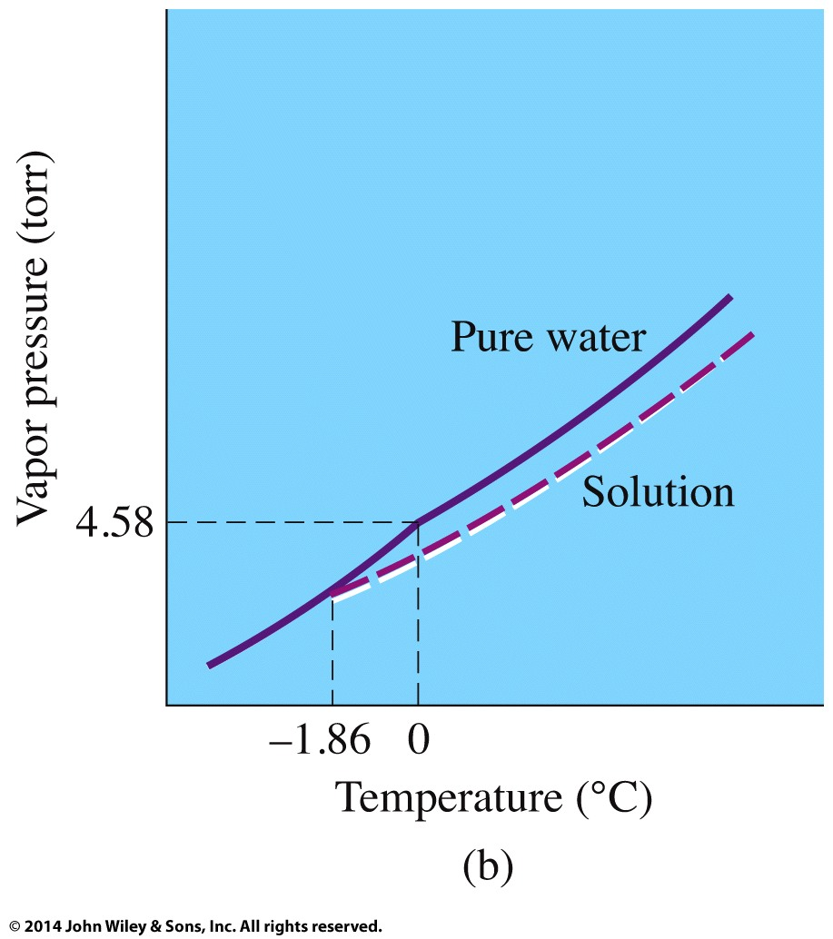
How does adding a solute change the properties of a solution?

Slide 40
Example – Colligative Properties
A 1.00-kg sample of water contains 0.500 mol of Na₃PO₄. What is the freezing point of the solution? K_{f} water = 1.86 °C/m.

Slide 41
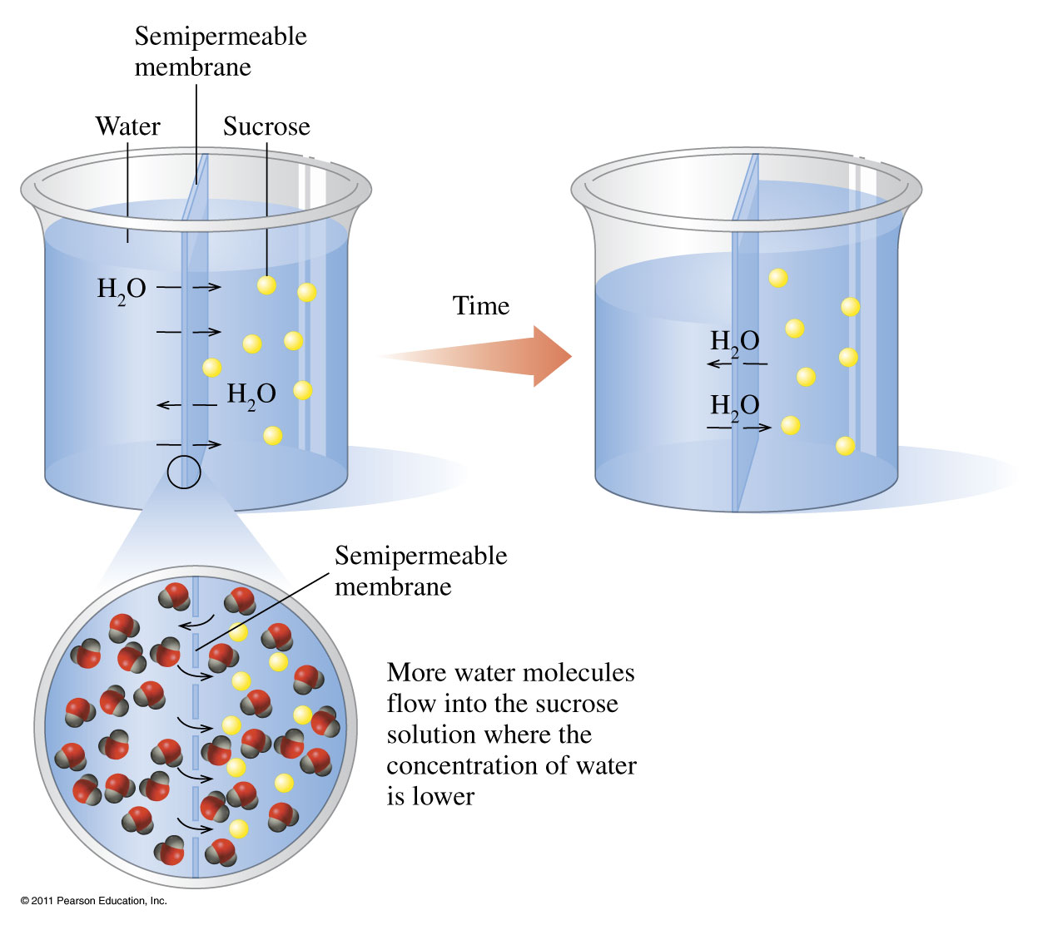
How does osmosis work?

Slide 42
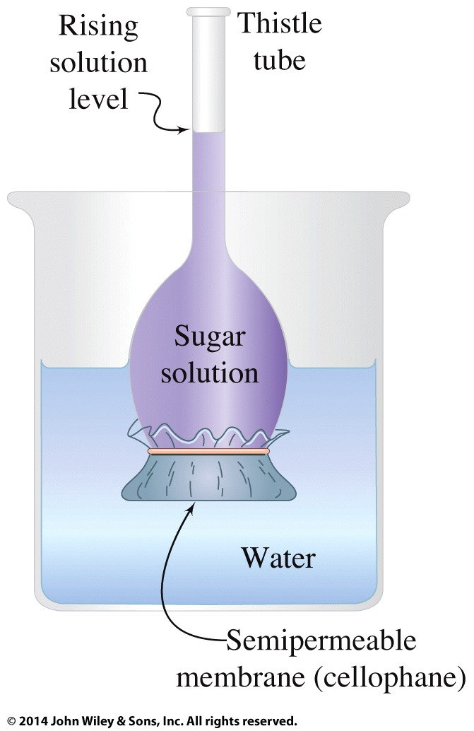
How does osmosis work?

Slide 43
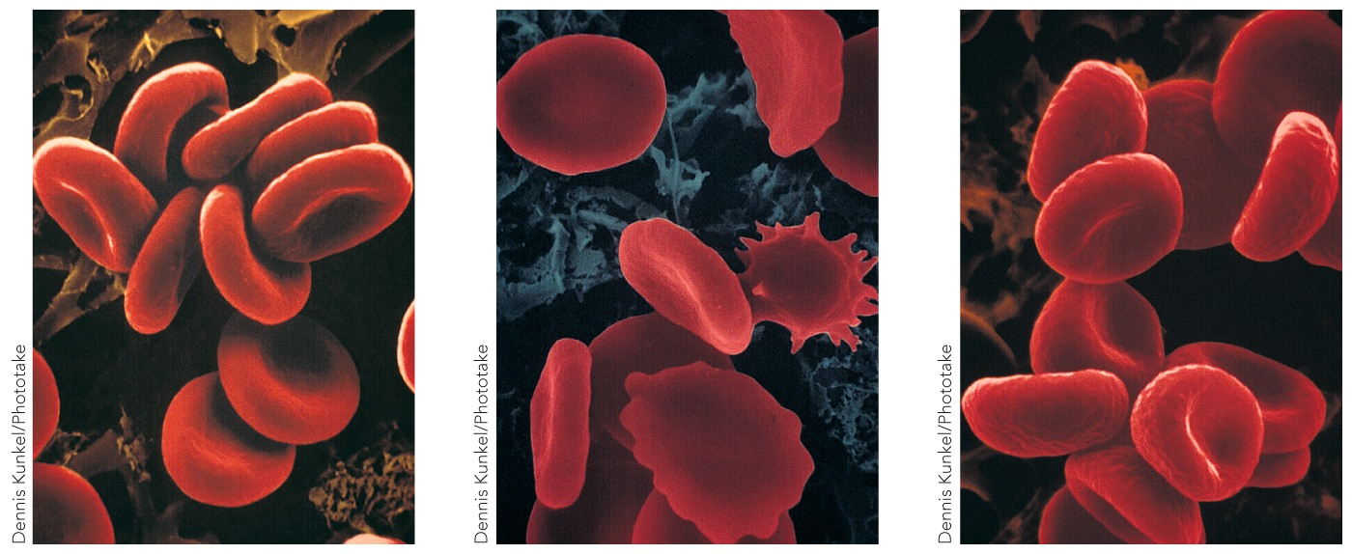
How does solution concentration affect red blood cells?
isotonic
hypertonic
hypotonic

Slide 44
A certain alloy is made by dissolving 5.31 g of copper and 4.03 g of zinc in 145 g of iron. Calculate the percent of each component in the alloy.

Slide 45
How much water must be added to 500.0 mL of 0.200 M HCl to produce a 0.150 M solution? (Assume that the volumes are additive.)

Slide 46
Suppose 1.01 g of FeCl₃ is placed in a 10.0 mL volumetric flask, water is added, the mixture is shaken to dissolve the solid, and then water is added to the calibration mark of the flask. Calculate the molarity of each ion present in the solution.

Slide 47
When aqueous solutions of lead(II) ion are treated with potassium chromate solution, a bright yellow precipitate of lead(II) chomate, PbCrO₄, forms. How many grams lead chromate forms when a 1.00 g sample of Pb(NO₃)₂ is added to 25.0 mL of 1.00 M K₂CrO₄ solution?

Slide 48
Standard solutions of calcium ion used to test for water hardness are prepared by dissolving pure calcium carbonate, CaCO₃, in dilute hydrochloric acid. A 1.745 g sample of CaCO₃ is placed in a 250.0 mL volumetric flask and dissolved in HCl. Then the solution is diluted to the calibration mark of the volumetric flask. Calculate the resulting molarity of calcium ion.

Slide 49
More problems
How many grams of calcium nitrate are required to make 500.0 mL of a 0.2221M calcium nitrate solution? Answer 18.22 g
What volume of a 6.217 M solution of copper(II) acetate is required to produce 2.177 mol of cupric acetate? Answer 0.3502 L
To what volume must 50.61 mL of 0.9466 M sodium phosphate be diluted to make a 0.3014 M solution of sodium phosphate? Answer 158.9 mL soln

